Slide 1
FortiDevSec Feature Verify

Slide 2
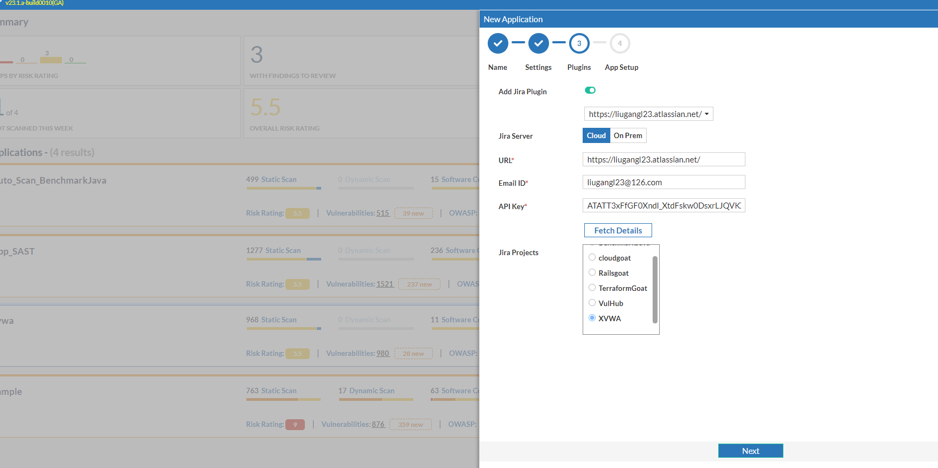
Create devsec scan application

Slide 3
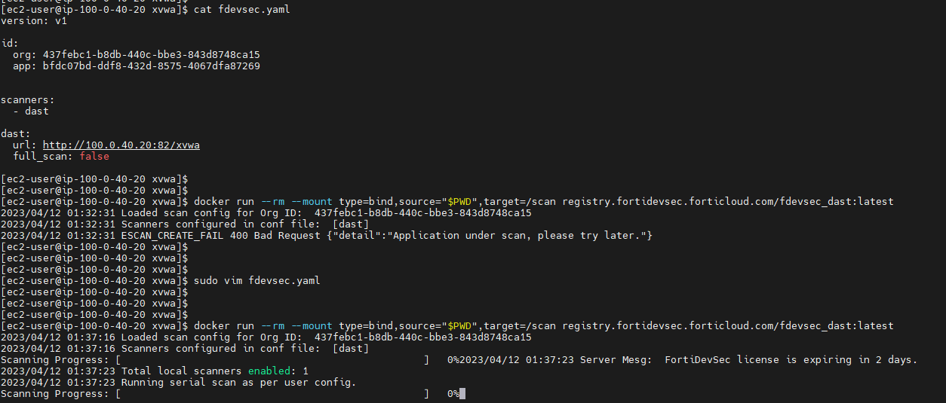
Dast Scan
Notes:
黑盒测试需要等待12个小时，默认就是显示0%，这是一个BUG。

Slide 4
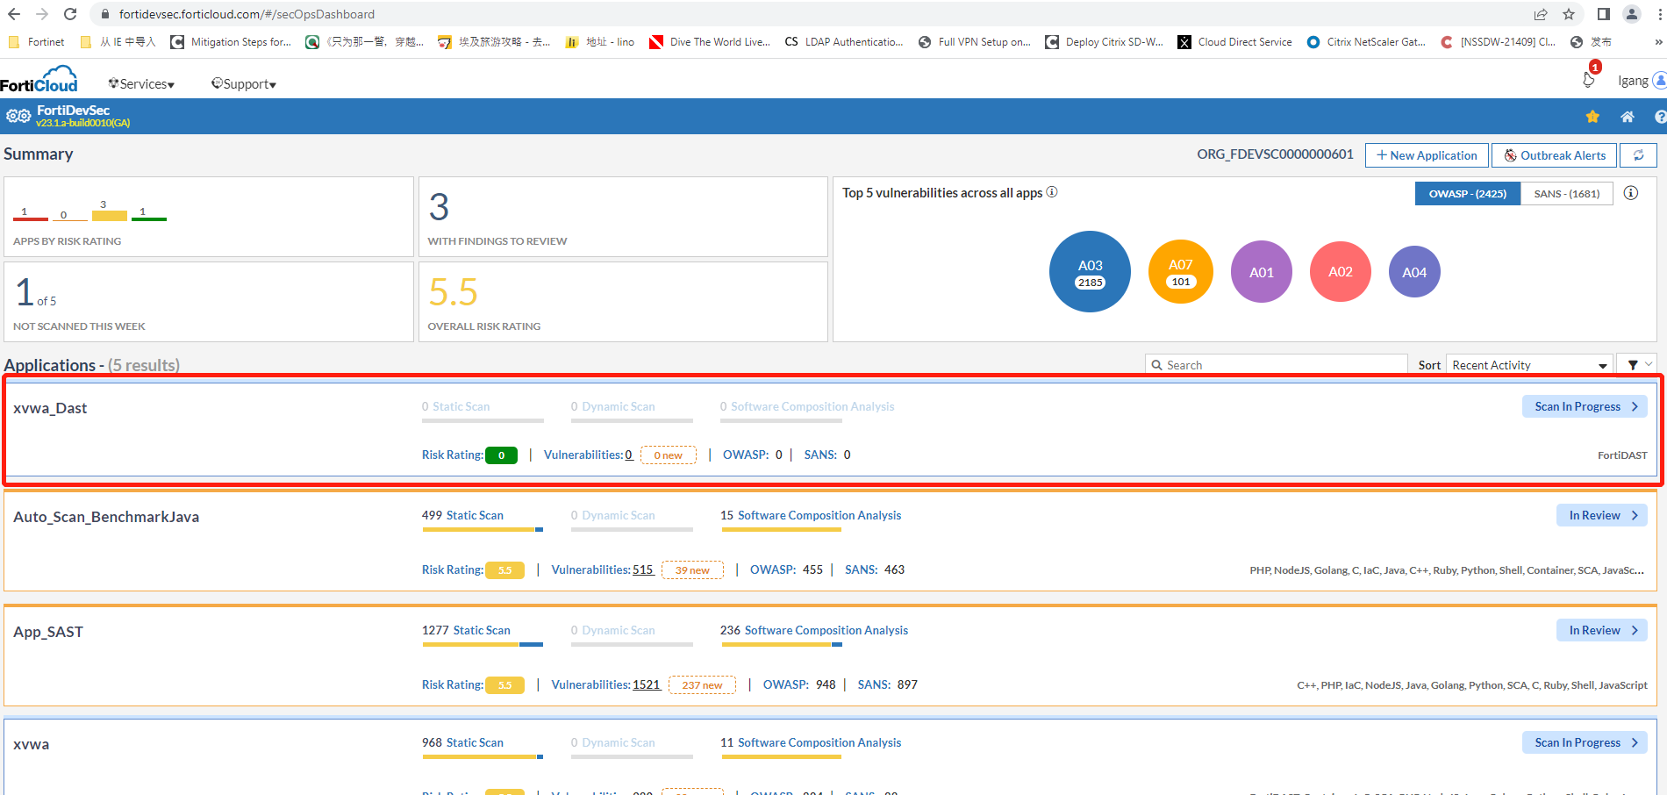

Slide 5
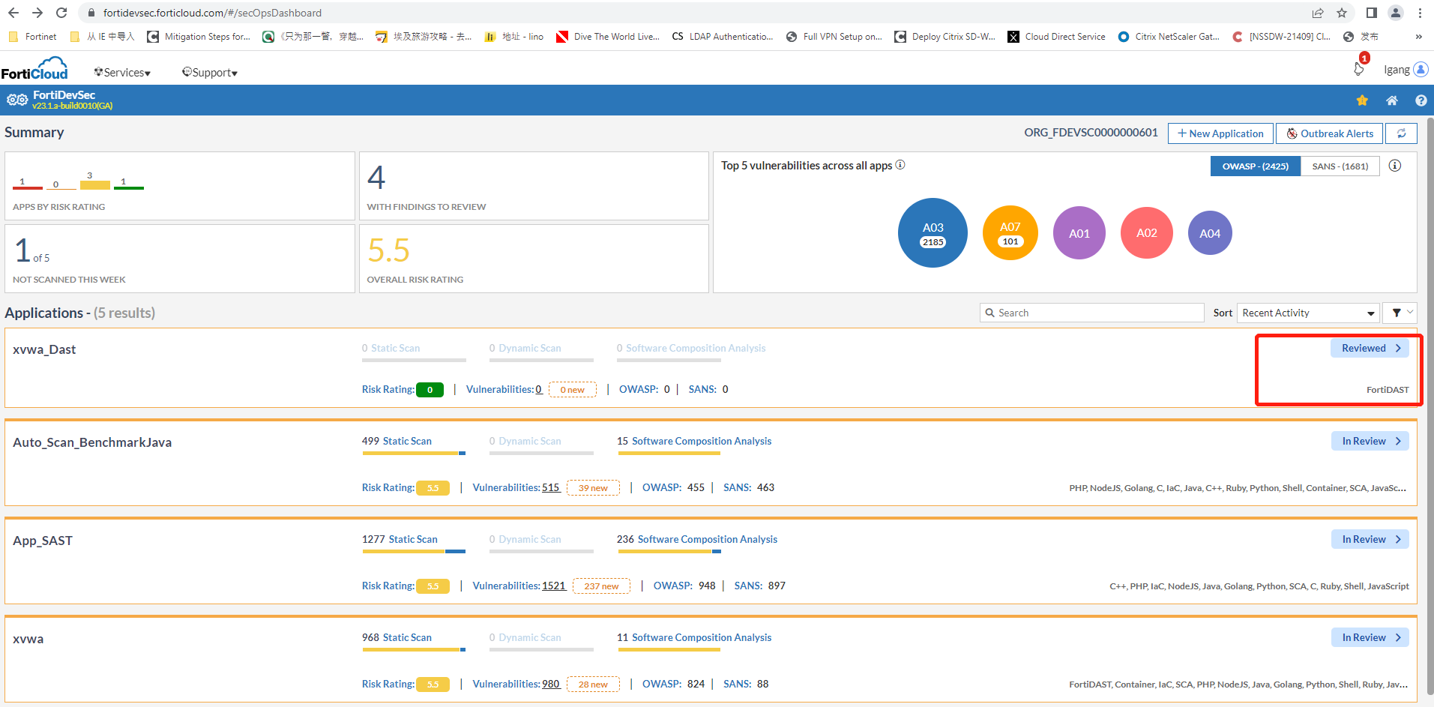

Slide 6
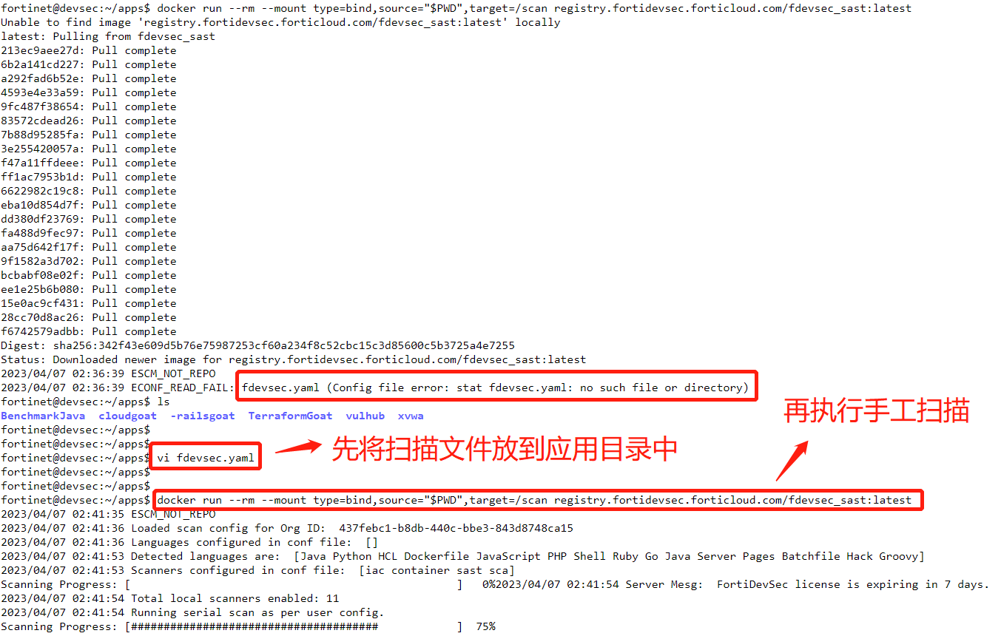
Sast Scan

Slide 7
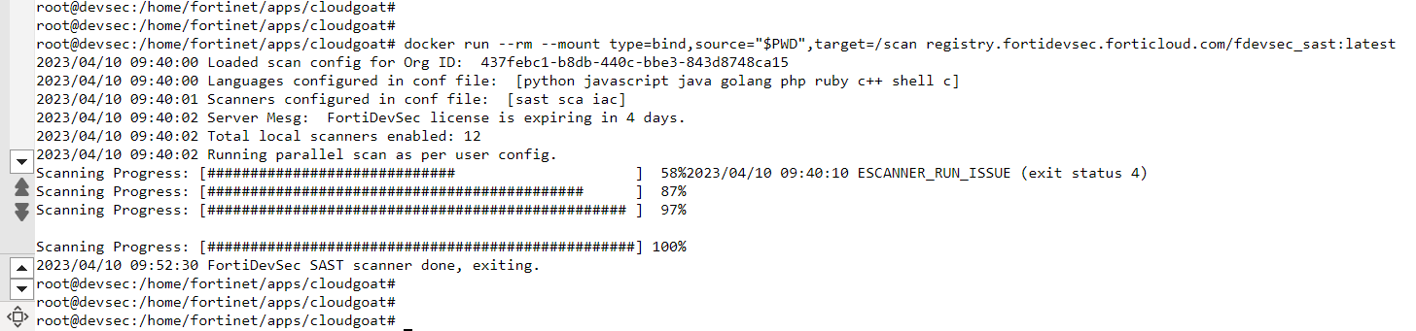
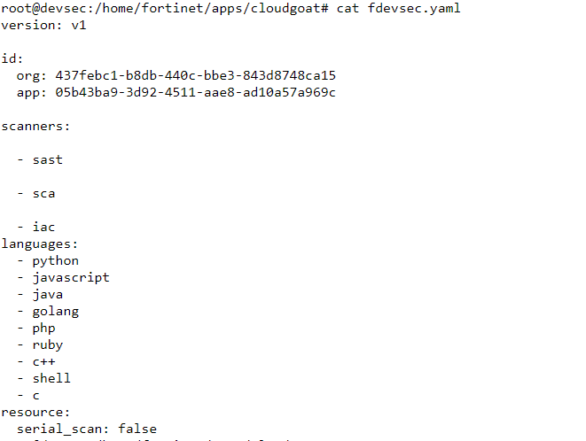

Slide 8
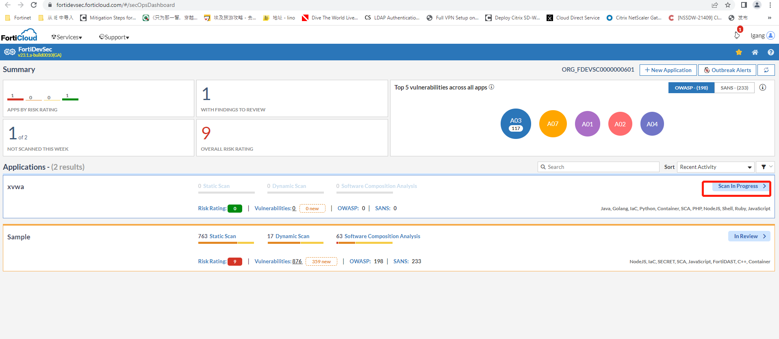

Slide 9
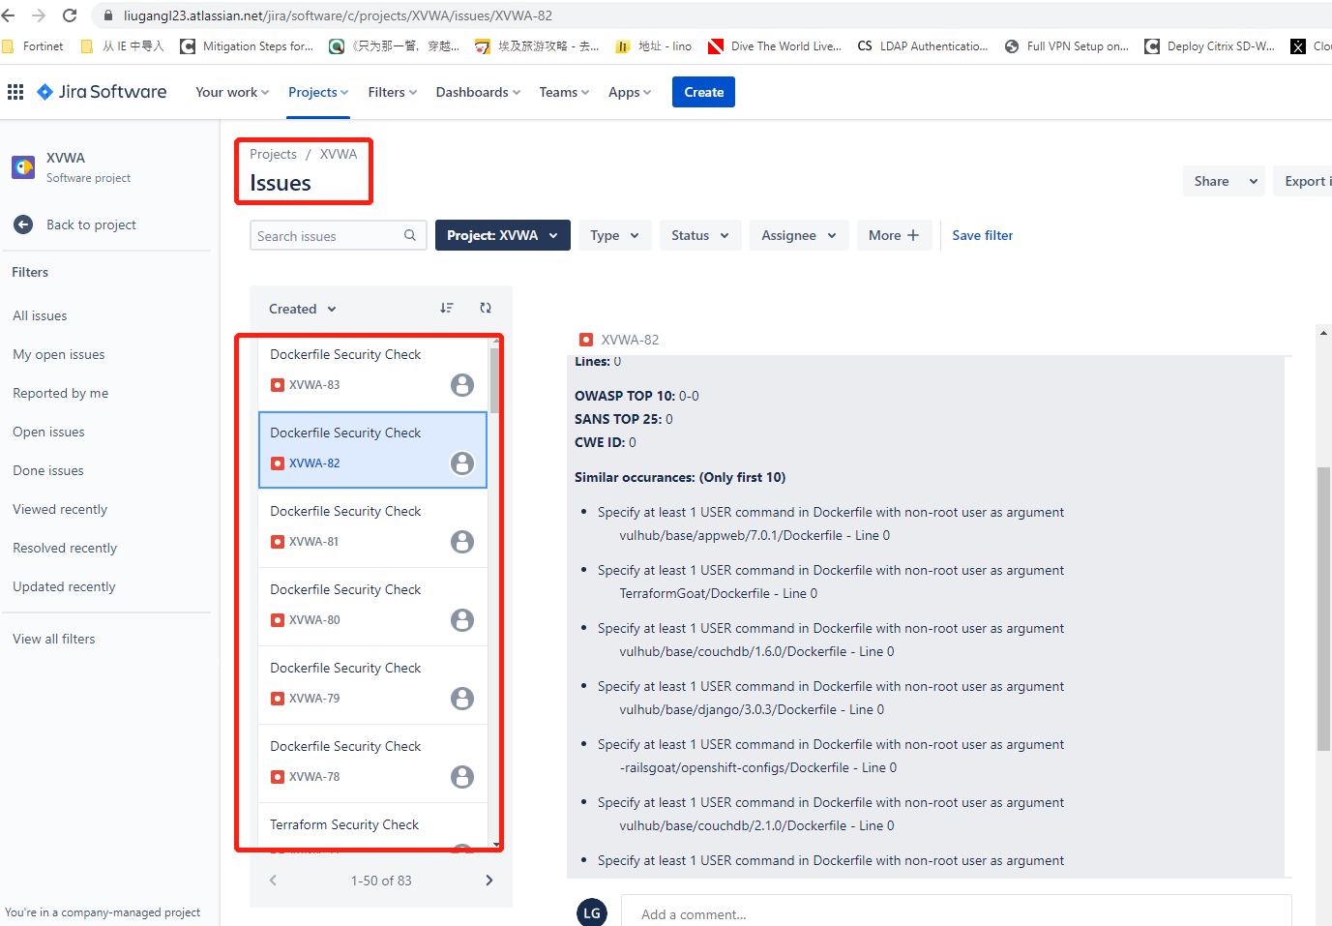

Slide 10
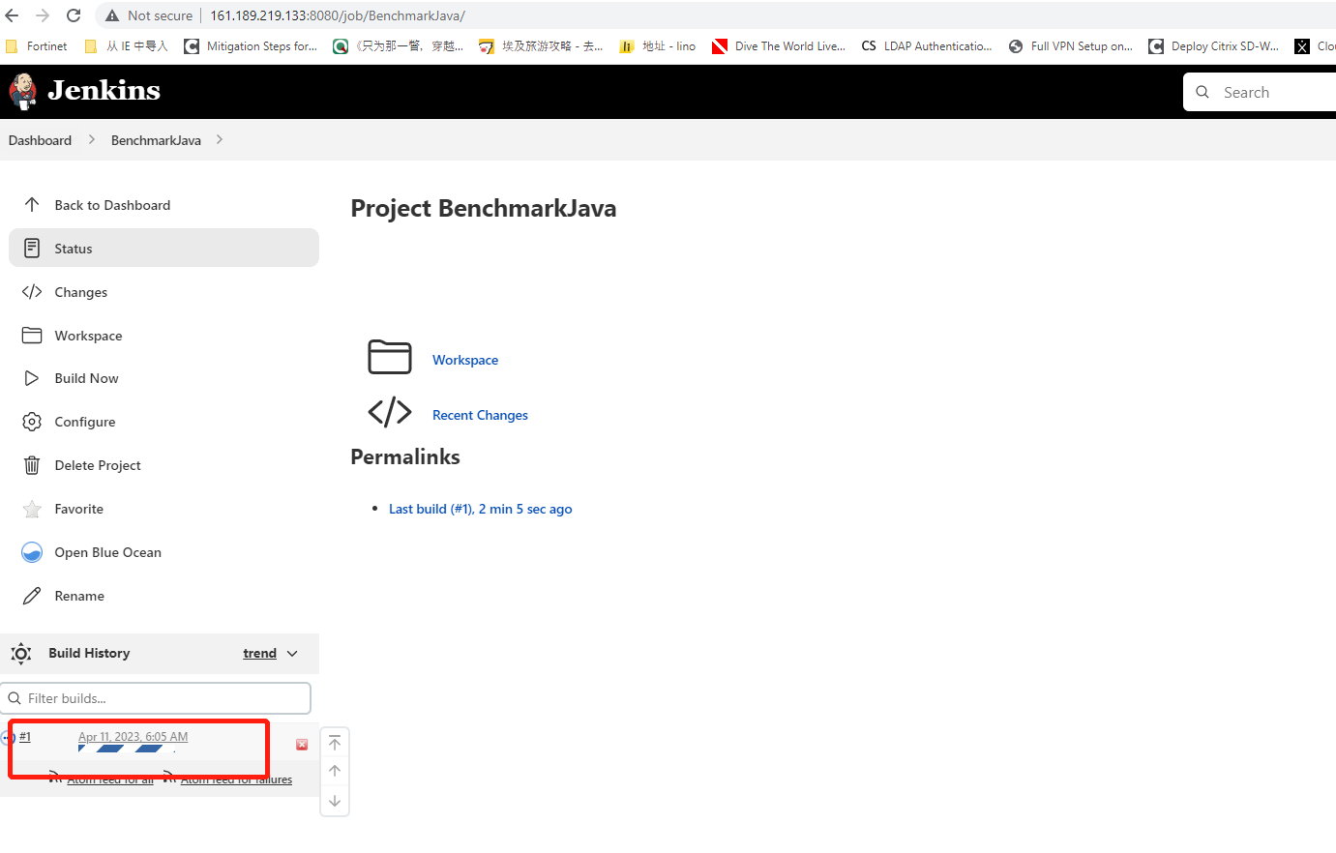
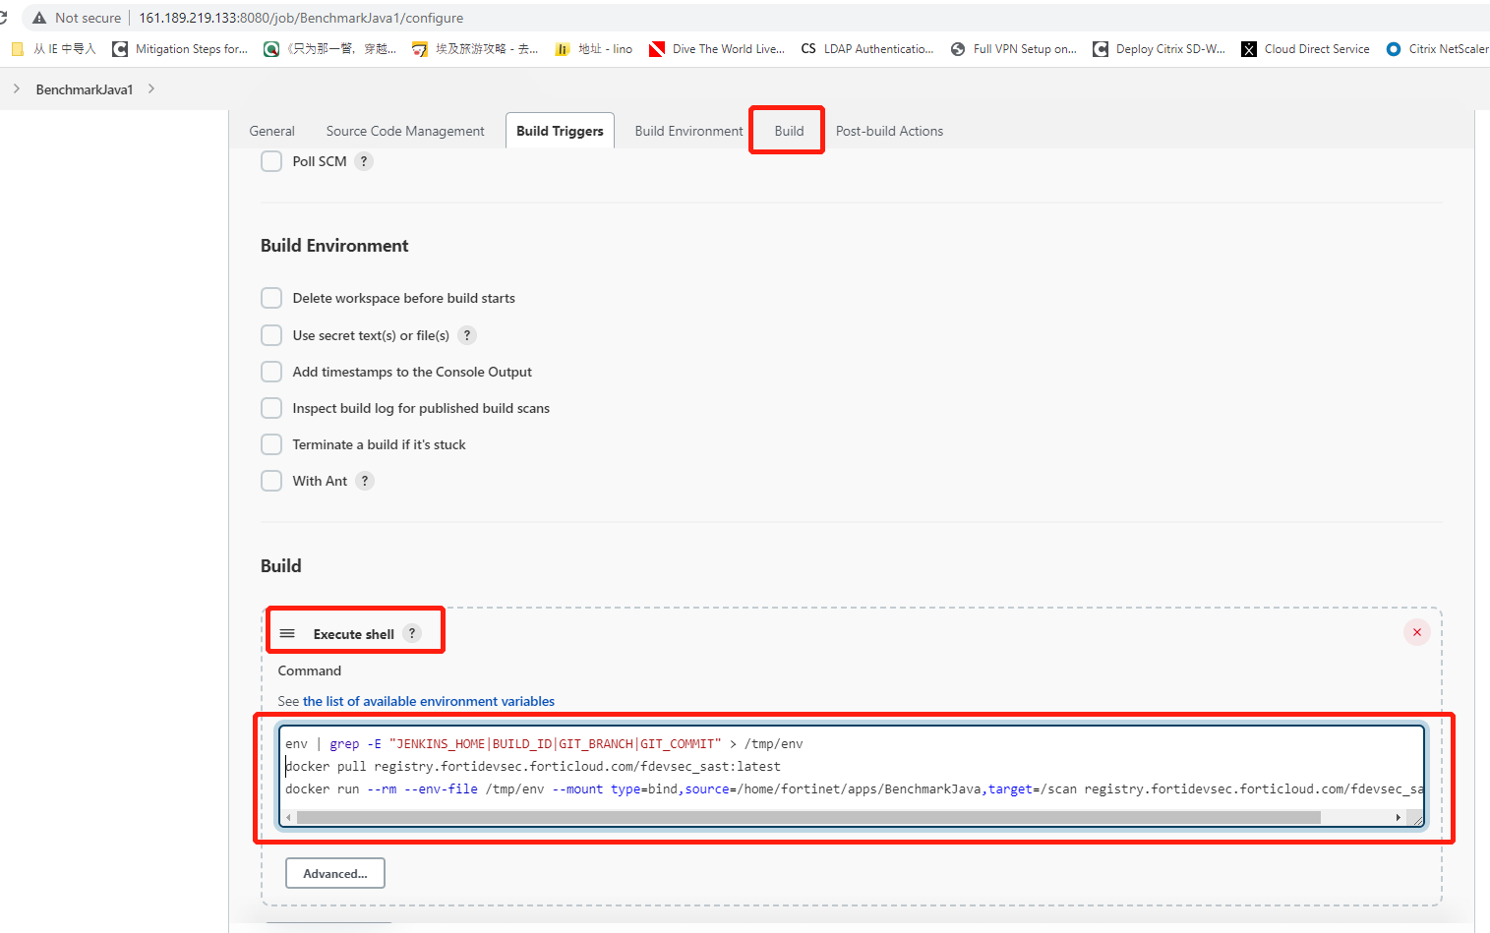
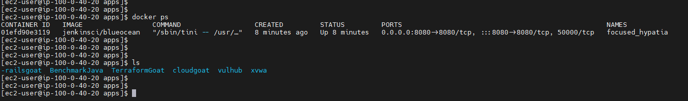
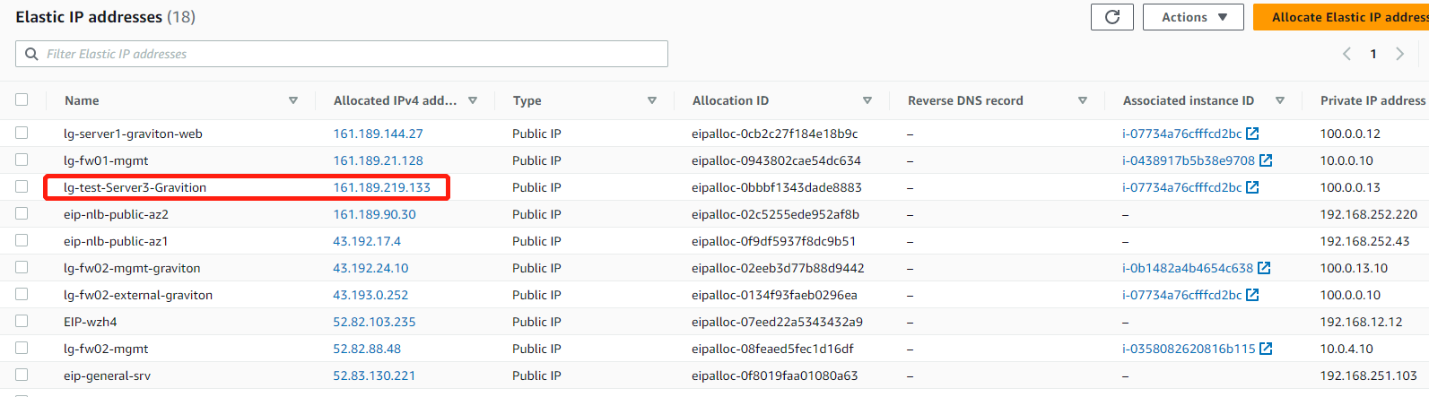
Notes:
Auto_Scan

Slide 11
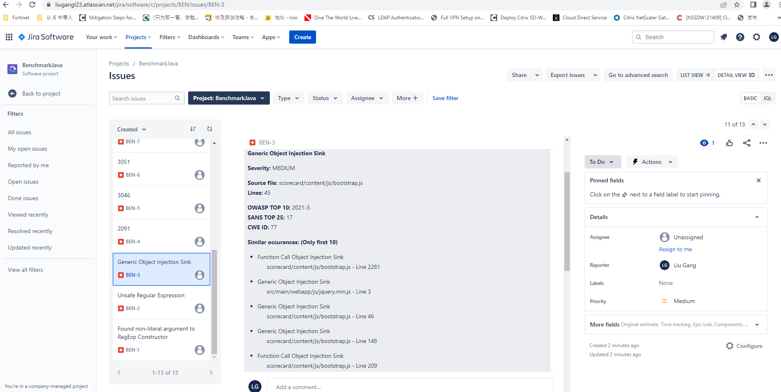
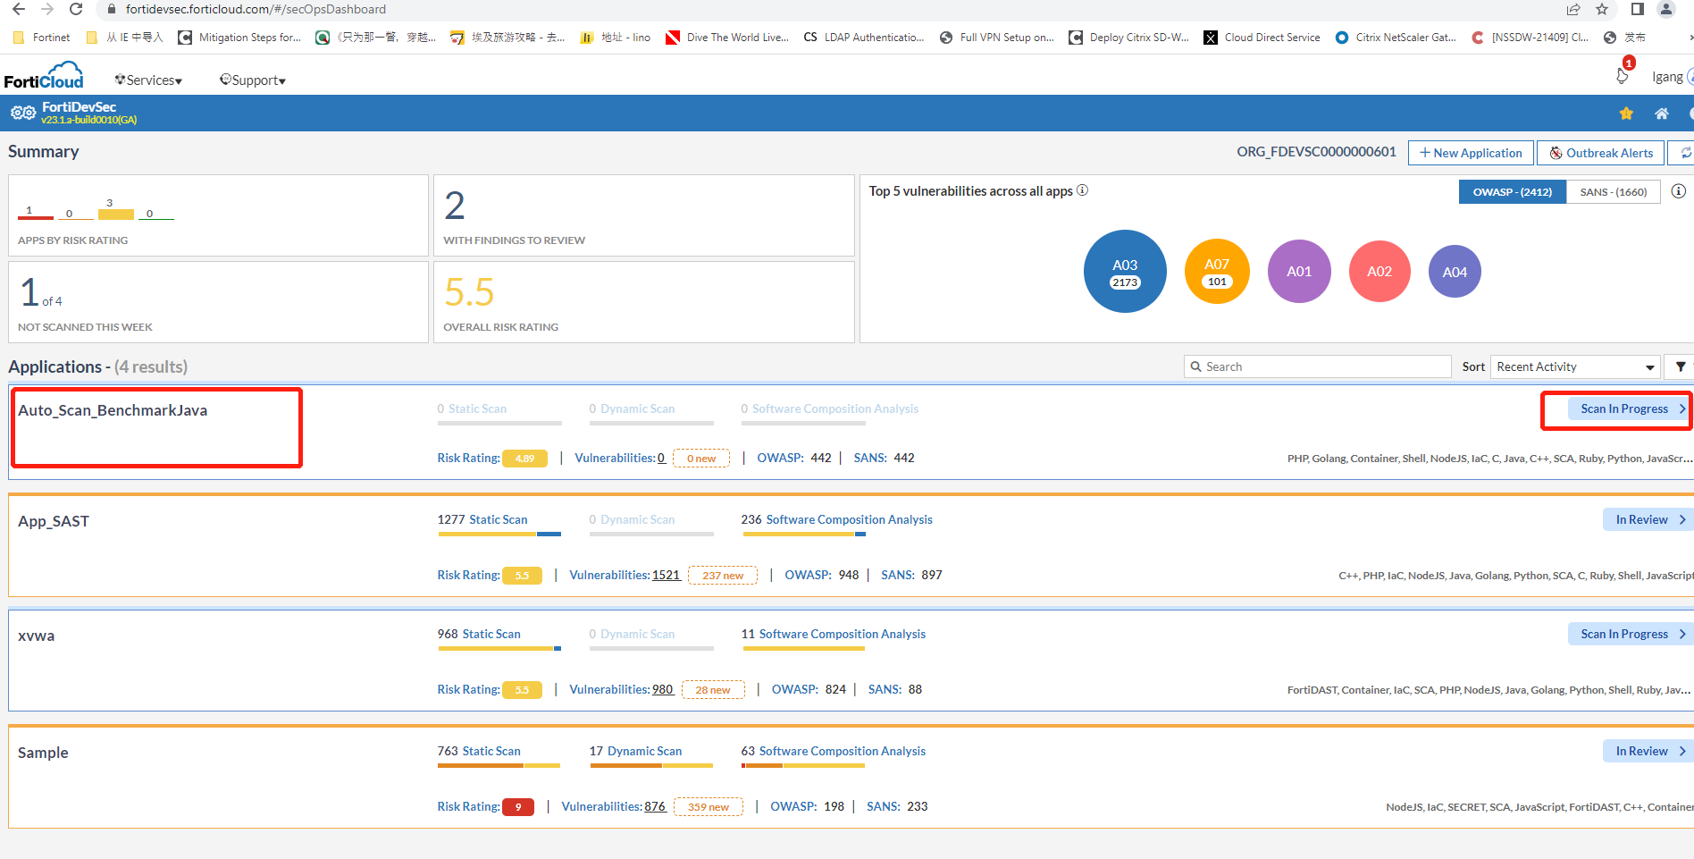
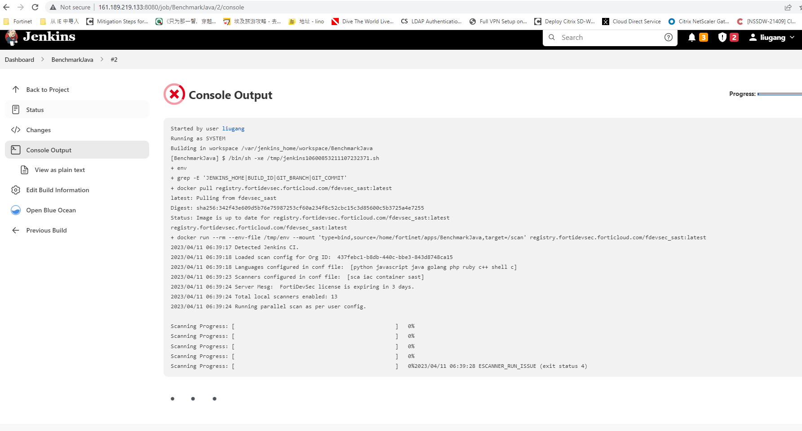

Slide 12
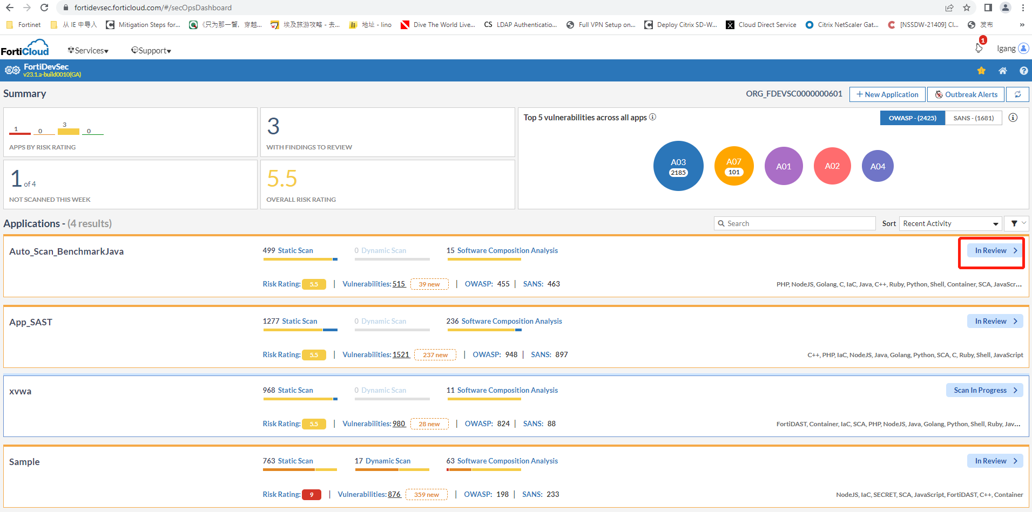
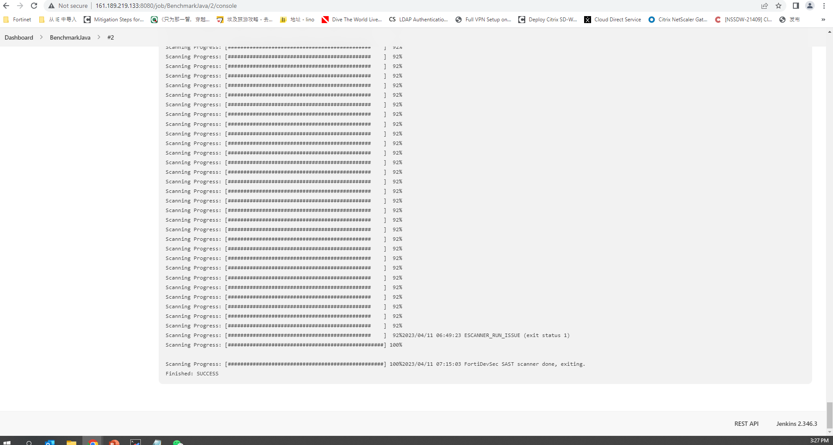
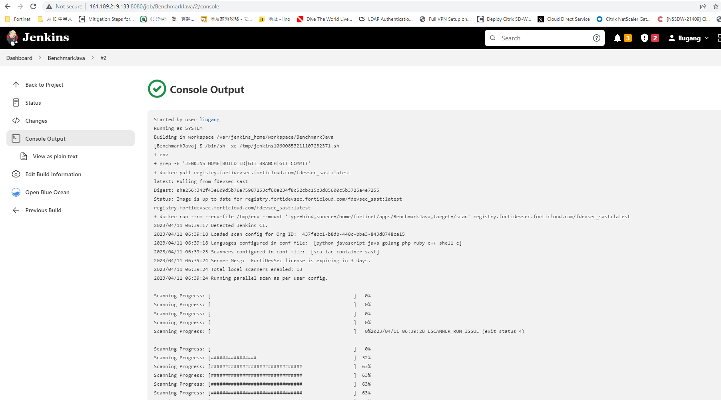

Slide 13
Product List
FortiDevSec | FC1-10-DEVSC-513-01-DD | FortiDevSec - Standard functionality Tier - Unlimited scans and unlimited apps for all scanners (SAST, SCA/OSS, Containers, IaC and Secrets) for up to 5 developer users (all developers working on the target apps to be scanned are counted). This also includes DAST or WebApp Vulnerability scanning provided by FortiDAST but limited to 5 apps. Use add on SKU to add more apps for DAST. This is stackable. Annual Subscription . FortiCare support included.
UNIT | SKU | Description
FortiDevSec - FortiDAST Add On | FC1-10-DEVSC-216-02-DD | Add on FortiDAST web vulnerability scanning / DAST functionality to FortiDevSec. Both products are to be used in SAAS version. This SKU provides access for scanning 5 apps using FortiDAST. This is on top of 5 apps for DAST that get included by default for each FortiDevSec license. Add on FortiDAST web vulnerability scanning / DAST functionality to FortiDevSec. Both products are to be used in VM version. This SKU provides access for scanning 5 apps using FortiDAST. This is stackable.

